Slide 1
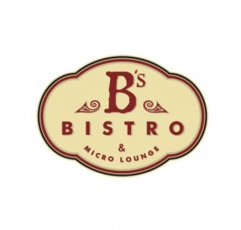
Café Bistro
Business Plan

Slide 2
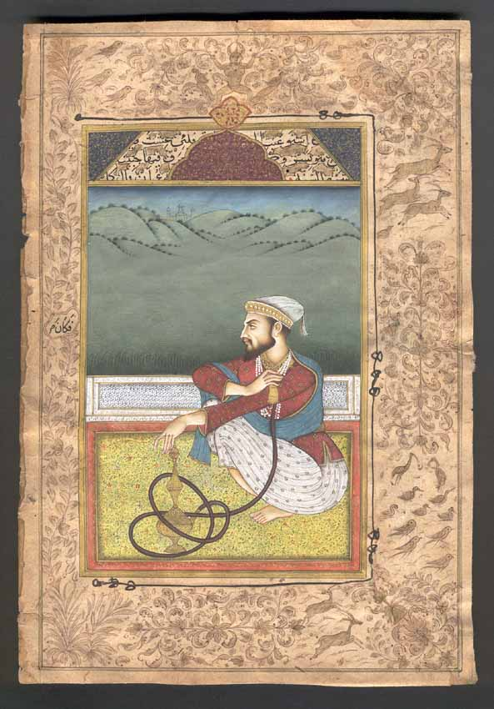
Mission Statement
We are Committed to using the finest ingredients in our recipes. We make you feel royal.

Slide 3
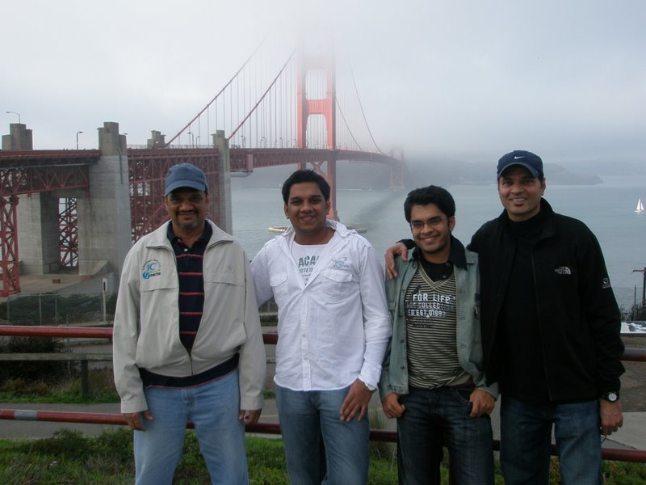
The Team
Partners - Shabbir Attarwala, Huzaifa, Gabaji, Hasnain and Mohan
Have catered to India’s finest restaurants such as The Taj, Hotel Leela, J.W Mariiot and many more
Experience from over 60 years
Partners are from different ethnical Indian backgrounds who have served also for foreign restaurants and hotels

Slide 4
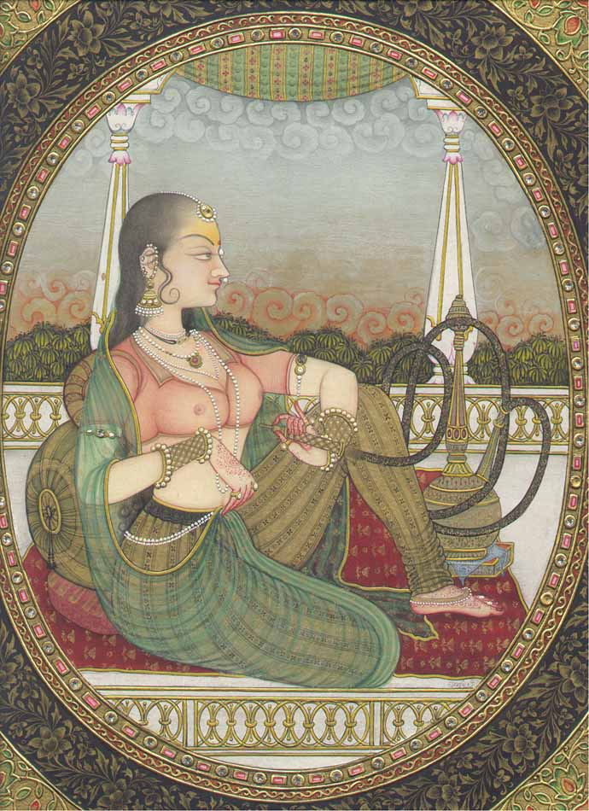
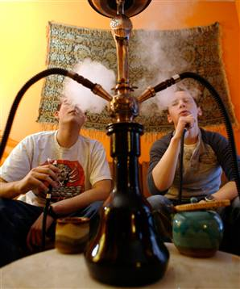
Market Summary
The concept of hookah originated In India, once the province of the wealthy, it was tremendously popular especially during Mughal rule. It is once again garnering the attention of the masses. The use of hookahs from ancient times in India was not only a custom, but a matter of prestige. Rich and landed classes would smoke hookahs. “Wikipedia”
Smoking molasses in a hookah is now becoming popular amongst the youth in India. It is a growing trend amongst youngsters and adolescents. There are several chain clubs, bars and coffee shops in India offering a variety of hookahs. The new trends emerging are that of non-tobacco hookahs with herbal flavors.

Slide 5
Opportunities
Hookah and Coffee and Snacks which can be consumed together with hygienic and professional standards which do not exist yet in Bombay, and this is a market yet to be exploited
Consumers often find themselves either in either unhygienic or find themselves in bad social environment when consuming these essential food and beverages.
Mediocre dealers and professionals can have meetings, without having to shell out high hotel fares in a city like Bombay
A nice clean and economically balanced place for students to hangout

Slide 6
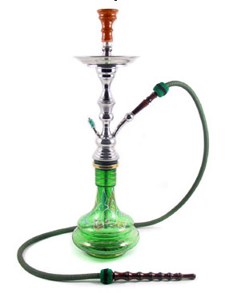

Business Concept
To import world class hookahs and tobacco free molasses from UAE
To serve multi-cuisine Indian food at relatively low prices
Create standards for hygiene and customer service
A clean place with a royal Persian theme
Treat customers royally as if treated like Sheikhs of the Gulf
Create an ambience of ancient Mughal culture mixed with modern Indian standards and music

Slide 7
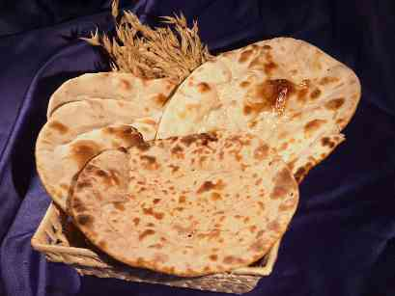

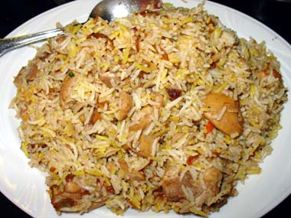
Competition
Have competition from various Hookah parlors around the city including Sheeha's, Hookah & Tikka, Bethaq.
These serve to either a very elite group of citizens or have very low hygienic standards
Lack in food and customer satisfaction
Café Bistro will strive to compete with hygienic and customer royalty
Will have authentic multi-cuisine Indian food

Slide 8
Marketing Plan
To focus on age groups between 18-25 and traders
Distribute fliers
Setup initial discounts
Will setup an regular customer discount for students
Price: 10$-15$ on Hookah as per flavor, 15$-40$ on food as per dishes and up to 2$ for tea and coffee
Have 10% Discount on Hookah on presenting Student Id’s

Slide 9
Goals and Objectives
To be the number Hookah pub in the city
To create unbeatable hygienic standards in it’s class
Cater to a variety of cuisines from around the country
Improve customer perception of courtesy
Train and reward staff
Self monitor with partners and assist Chef’s in the initial days
Gather Chef’s from around the country to get as authentic as possible

Slide 10
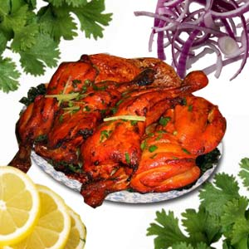
Goals and Objectives
Have up to 150% profit margin on food products
Have up to 20% profit margin on beverages
Have up to 300% profit margin on Hookah’s
Give side dishes and unlimited charcoal for smoking Hookah complimentary unlike competitors

Slide 11
Resource Requirements
Chef’s, cook, Waiters, Cleaners, Manager
Ovens, Kitchen Supply, Music system, Air conditioning, strong WI-FI System
Personal Capital, Personal loan, Bank loan
Distribute flyer’s across Colleges, TV and Radio advertisemens
Al-Fakher Mollases, Charcoal, Aunthentic Massala’s (spices), Vegetable, Meat and Rice
Transport, Security, Valet parking

Slide 12
Risks and Rewards
Low turn out of guests
Use more promotion techniques
Set up initial discounts
Dislike of taste in food
Can change the menu accordingly
Note down the majority of regular ethnic group visiting, and modify recipes and menu to meet their taste

Slide 13

Risks and Rewards
Dislike of Smokey ambience due to Hookah
Could make separate smoking and non-smoking zones
Food and Beverage industry is the currently the fastest growing industry in the financial capital of India
Average Mumbaikar spends 70% of his time eating out per research done by the IIT University
Can become the no one provider for Hookah’s, snacks and Coffee as everything is available in one place at reasonable prices and excellent service

Slide 14
Key Issues
Educating people on Tobacco free herbal molasses
If not addressed early enough, can have an negative image on Hookah smoking
Licensing: Obtaining a license for indoor smoking could be a hassle as local authorities also have to be educated about tobacco fee herbal molasses

Slide 15
Financial Planning
To take a 20,000$ loan from an angel Investor.
Angel Investor to act as an mentor and a sleeping partner.
To have an additional 5000$ ready to deploy if need arises.
After loan is complete, angel investor will still be considered a partner in the business.
Commence business in 2010, plan to acquire the required loan amount by the end of 2009

Slide 16
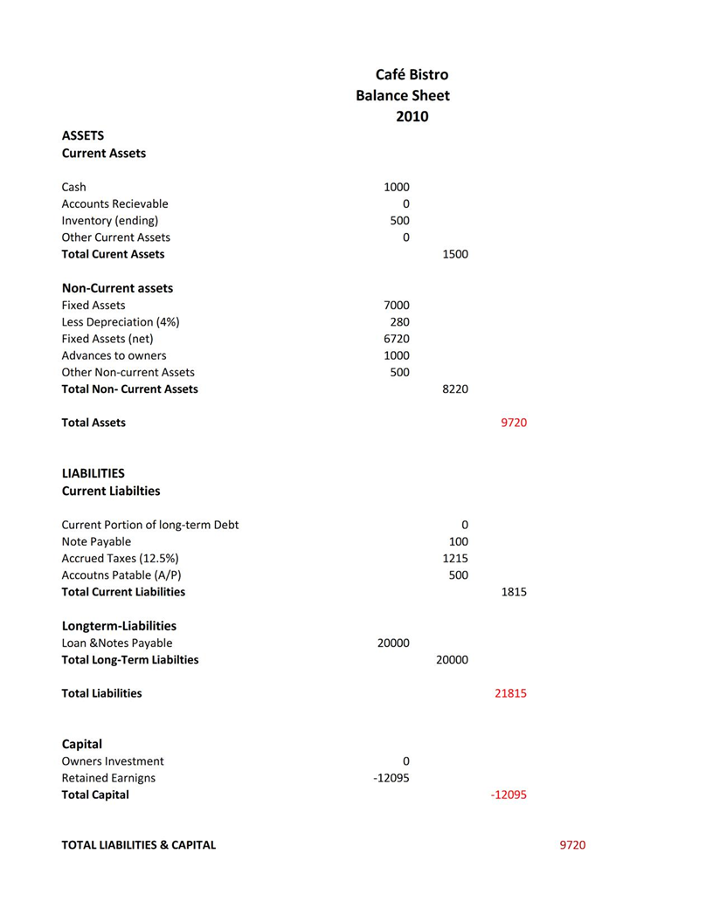
Balance sheet 2010

Slide 17
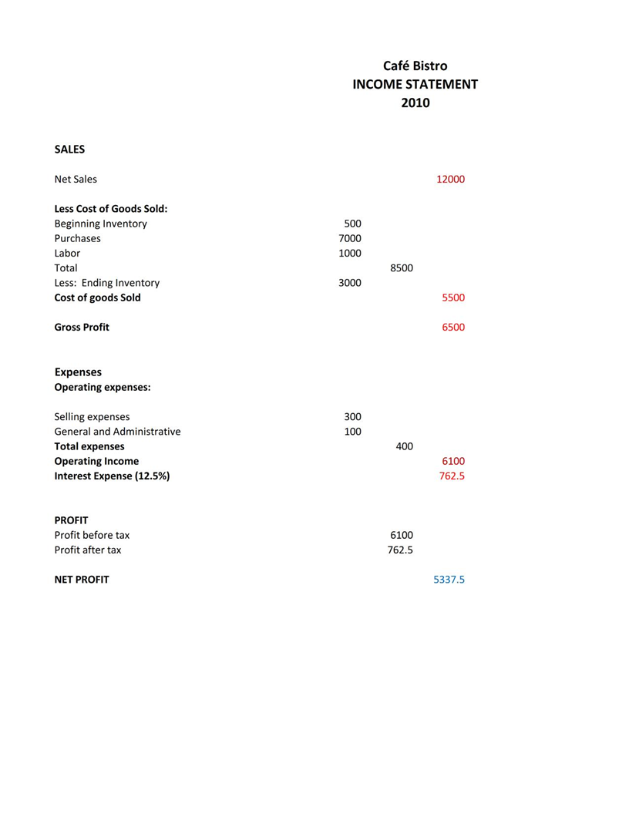
P&L Projection 2010

Slide 18
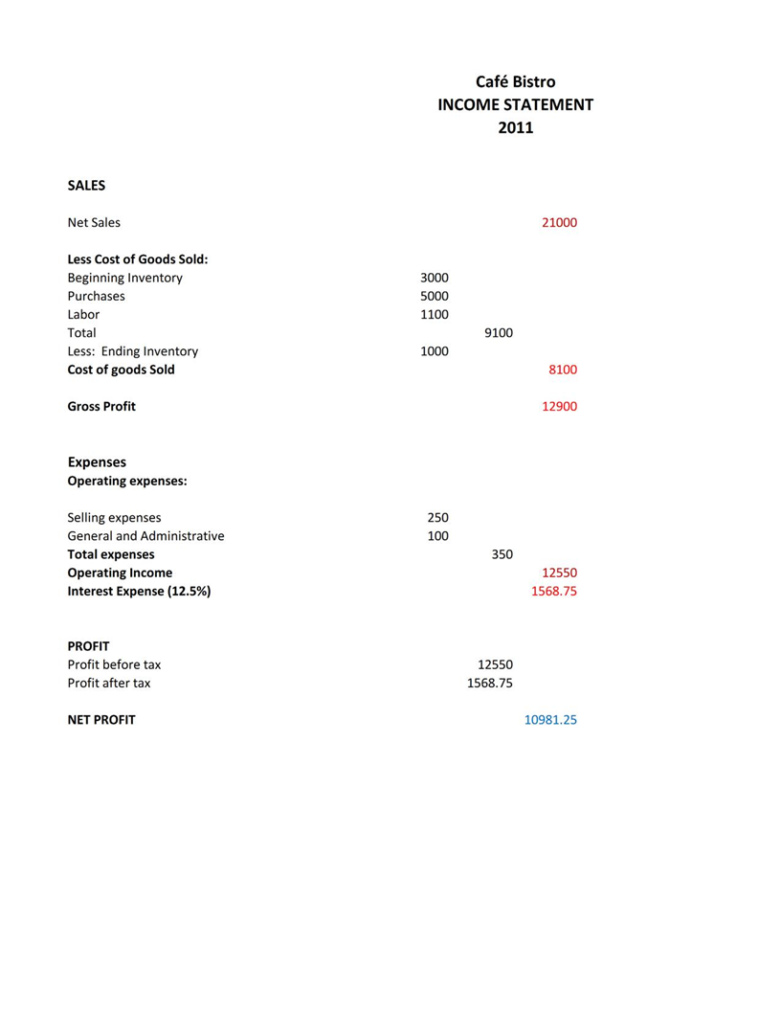
P&L Projection 2011

Slide 19
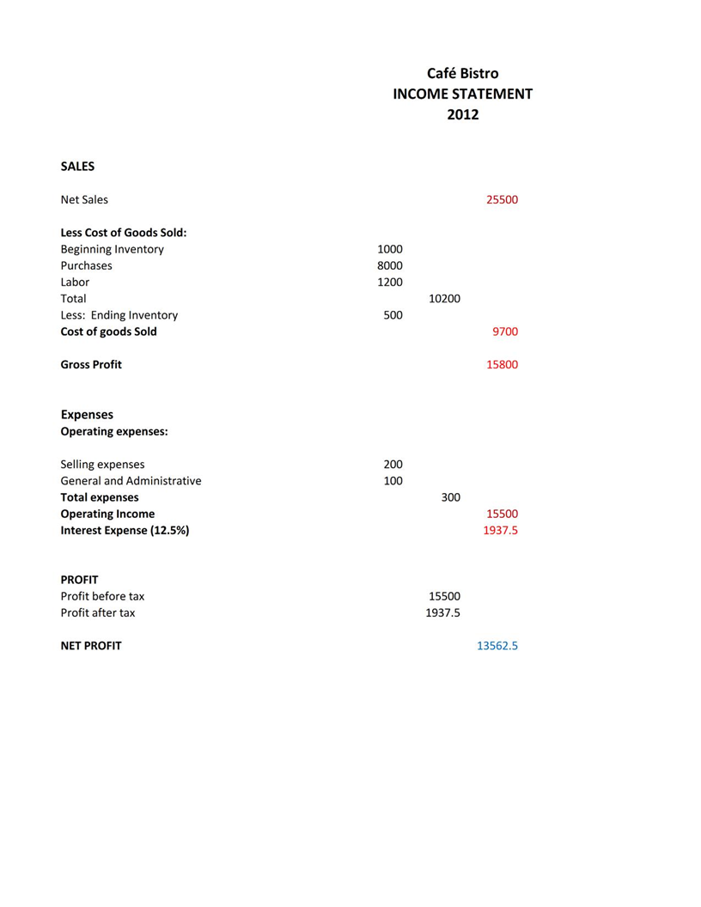
P&L Projection 2012

Slide 20
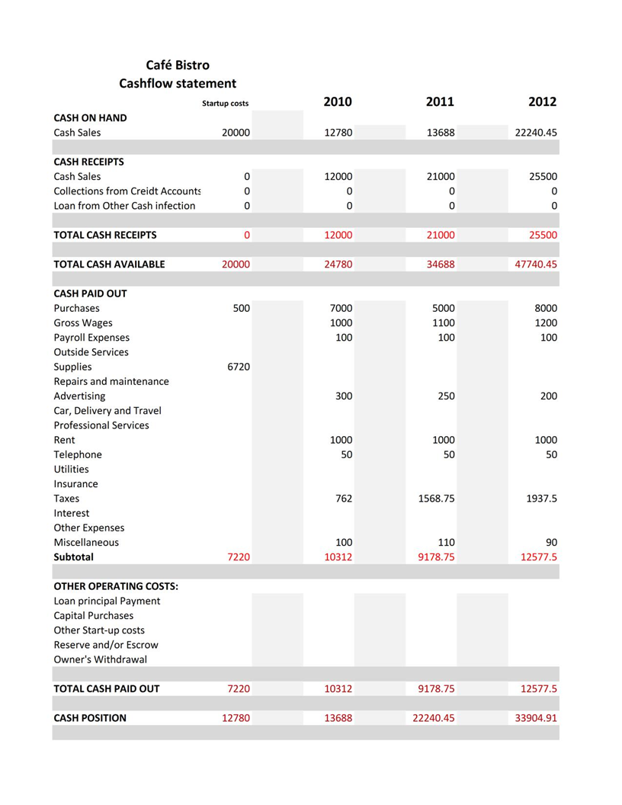
Three year Cash-flow Projection

Slide 21
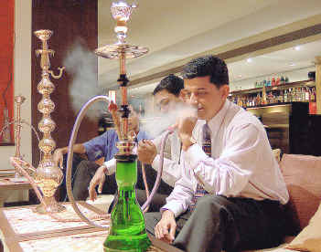

Slide 22
Café Bistro
Business Plan

